Slide 1

Towards Lightweight Routing: Adaptive and Explainable Orchestration of Models and Agents
Group Members:
Zainab Khalid 22P-9061
Ume Taqadus 22P-9393
Faryal Hanif 22P-9173
Project Supervisor:
Mr. Shahzeb Khan

Slide 2
Introduction
Our project introduces a novel approach to AI system management: a lightweight routing system designed for optimal efficiency and cost-effectiveness.
Balanced Efficiency & Cost
Adaptive Model Routing
Strategically routes queries to minimize operational expenses without compromising performance.
Routes Queries to the most suitable model depending on the complexity and type
Precision Agents
Adaptive & Transparent
Incorporates task-specific agents for highly accurate and specialized responses.
Features a system that learns and evolves, providing clear explanations for its routing decisions.

Slide 3
Motivation:
Escalating AI Costs
Demand for Adaptive Solutions
Promoting AI Transparency
The increasing reliance on large, powerful AI models makes their deployment and usage prohibitively costly and often inefficient.
There is a critical need for lightweight, adaptive routing mechanisms that can dynamically balance performance and resource utilization.
Our system aims to enhance trust and usability by making AI decisions more transparent, efficient, and user-friendly.
Sustainable AI Deployment
Boosting Local Tech
This project aligns with global efforts toward responsible and sustainable AI practices, reducing the environmental footprint of large models.
By enabling affordable multi-model AI solutions, this project contributes significantly to the advancement of Pakistan's burgeoning tech ecosystem.

Slide 4
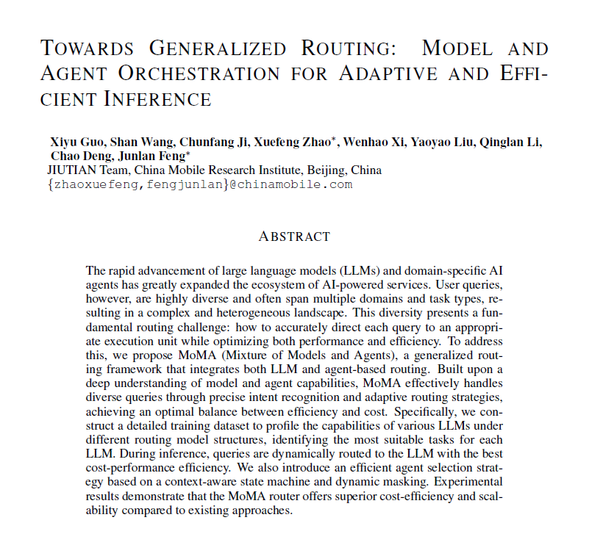
Base/Reference Paper:
Published: Sep 11 ,2025

Slide 5
Problem Statement:
Despite rapid advancements in language models, a critical gap remains: users lack a lightweight routing system that efficiently adapts to query complexity, balances cost with performance, and provides transparent decision-making.
Current systems struggle with lightweight routing frameworks , leading to suboptimal resource use, increased operational costs, and a lack of insight into how AI decisions are made.

Slide 6
Solution:
Our proposed system integrates lightweight and adaptive techniques to deliver efficient, transparent, and cost-aware query routing, addressing the limitations of existing AI orchestration methods.
Routing Layer
1
Efficiently directs incoming queries to the most suitable AI model or specialized agent based on query complexity and resource availability.
Explainability Layer
2
Provides clear and concise reasoning for why a particular query was routed to a specific model or agent.
Cost-Awareness Module
3
Intelligently balances model performance with financial and computational resource constraints.
Dashboard & Visualization
4
Offers an intuitive interface to display routing decisions, model usage patterns, and cost-performance trade-offs.
5
Lightweight Design
Ensures the entire system is optimized to run efficiently in low-resource environments, minimizing infrastructure demands.

Slide 7
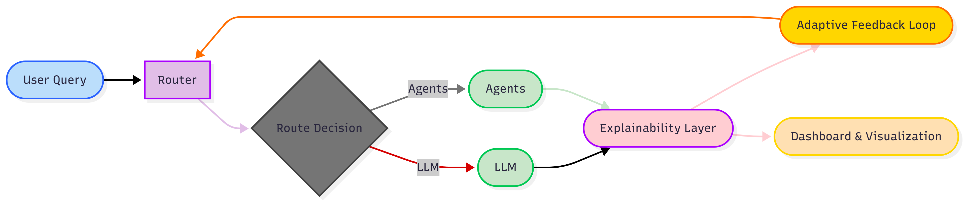
Solution Flow Chart:
The flow chart illustrates the intricate process of our lightweight routing system. A query enters, is analyzed by the routing layer, and then intelligently directed to either a large language model or a specialized agent. An adaptive feedback loop continuously refines this process, while the explainability layer provides transparency at every step.

Slide 8
Project Scope:
Our project encompasses a multifaceted approach to developing a robust and intelligent AI routing system. We are focusing on key areas that ensure both functionality and future scalability.
Application Development
1
Creating a user-friendly interface and the core logical framework for query management.
Lightweight Model Development
2
Engineering compact and efficient models optimized for rapid processing and minimal resource consumption.
Resource Efficiency
3
Implementing strategies to minimize computational overhead and operational costs across the system.
Integrated Feedback Loop
4
Designing a mechanism for continuous learning and adaptation based on system performance and user interactions.
Real-World Application Testing
5
Validating the system's performance and effectiveness through rigorous testing in practical scenarios.

Slide 9












Goals:
Our overarching goal is to design and implement an AI routing system that is not only efficient and adaptive but also fully transparent, fostering user trust through explainable decisions and validated real-world performance.
Lightweight Router
Adaptive Feedback
Develop a compact and efficient routing mechanism for diverse AI tasks.
Integrate a continuous learning loop to enhance routing accuracy over time.
Resource Efficiency
Real-World Testing
Ensure optimal utilization of computational resources to minimize costs.
Validate system performance and reliability through practical applications.
Orchestrate AI Assets
Explainability Layer
Direct queries to either specialized agents or general-purpose models.
Provide clear justifications for every routing decision made by the system.

Slide 10
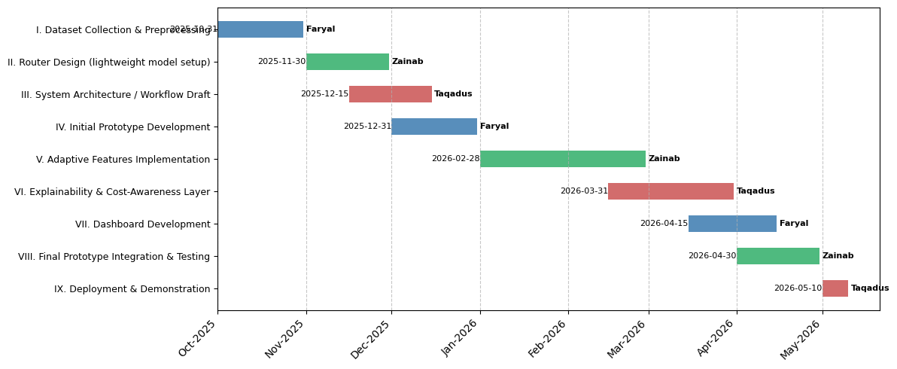
Objectives and Team Work:

Slide 11
Expected Results:
Upon completion, our project is poised to deliver an AI orchestration system, redefining how models and agents
interact to serve user queries.
1
Functional Query Router
A fully operational system capable of intelligently directing queries to the most appropriate models and agents.
2
Intelligent Task Routing
The ability to route simple tasks to smaller, more efficient models and complex tasks to more powerful, specialized AI.
3
Self-Improving System
A system that continuously improves its routing accuracy through adaptive feedback and effective task escalation.
4
Transparent Operations Dashboard
An intuitive dashboard that visualizes routing decisions, model usage, and the crucial cost-performance trade-offs.
5
Reduced Model Dependency
Significantly decreased reliance on large, resource-intensive models, making AI accessible in low-resource environments.
6
Validated Real World Impact
Empirical evidence from real-world testing demonstrating the system's efficiency, adaptability, and transparency in action.

Slide 12
References
Guo, X., Wang, S., Ji, C., Zhao, X., Xi, W., Liu, Y., ... & Feng, J. (2025). Towards Generalized Routing: Model and Agent Orchestration for Adaptive and Efficient Inference. arXiv preprint arXiv:2509.07571.
Ong, I., Almahairi, A., Wu, V., Chiang, W. L., Wu, T., Gonzalez, J. E., ... & Stoica, I. (2024). Routellm: Learning to route llms with preference data. arXiv preprint arXiv:2406.18665.
Shuhao Chen, Weisen Jiang, Baijiong Lin, James Kwok, and Yu Zhang. Routerdc: Query-based router by dual contrastive learning for assembling large language models. Advances in Neural Information Processing Systems, 37:66305–66328, 2024.
Dujian Ding, Ankur Mallick, Chi Wang, Robert Sim, Subhabrata Mukherjee, Victor Ruhle, Laks VS Lakshmanan, and Ahmed Hassan Awadallah. Hybrid llm: Cost-efficient and quality-aware query routing. arXiv preprint arXiv:2404.14618, 2024.

